Slide 1

Getting Started

Slide 2

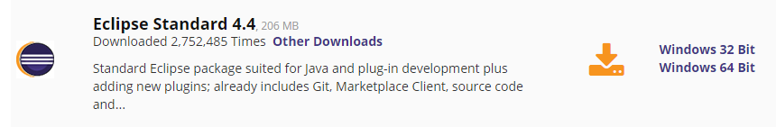
Eclipse
https://www.eclipse.org/downloads/

Slide 3
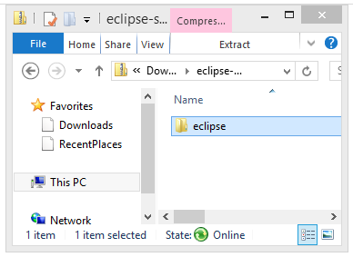
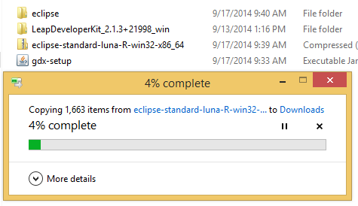
Eclipse
Extract it to somewhere useful

Slide 4

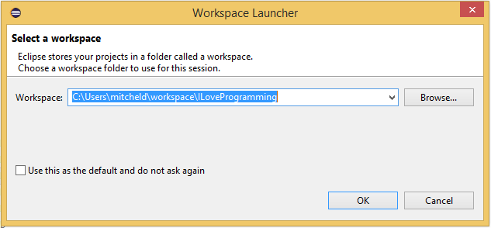

Eclipse - Install Gradle
When using a game library, there are often some external plugins that you might need. LibGDX uses Gradle [and the Android SDK if you make your game for Android, but we won’t cover that until later]
Choose any workspace, just remember where you put it!

Slide 5
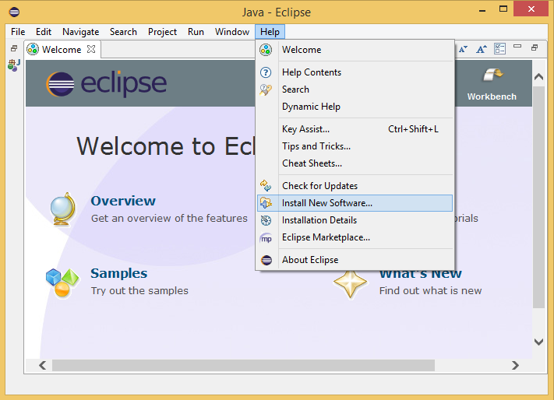
Eclipse - Install Gradle

Slide 6
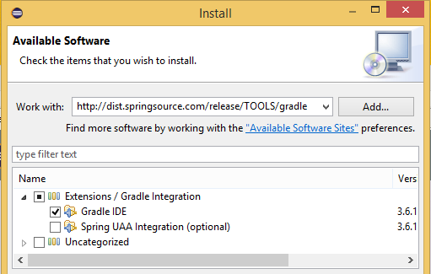
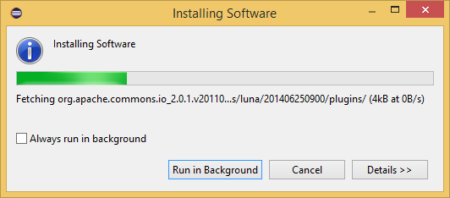
Eclipse - Install Gradle
Note: All this information can be found at
https://github.com/libgdx/libgdx/wiki/Setting-up-your-Development-Environment-%28Eclipse%2C-Intellij-IDEA%2C-NetBeans%29
http://dist.springsource.com/release/TOOLS/gradle
Now just keep clicking
yes/agree/yup/next/finish
and stuff until everything is
installed

Slide 7

Eclipse - Easy Way
OR - An alternative is to just get a copy of this from Mitch, with everything pre-installed

Slide 8

LibGDX
Time to create a project
We Will use LibGDX
Because it provides a simple-to-use environment, and makes learning game concepts much easier
Download from: http://libgdx.badlogicgames.com/download.html

Slide 9
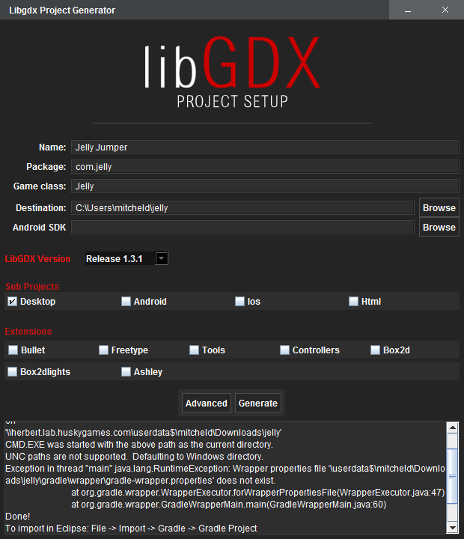
LibGDX Setup
Generate a
project with the
LibGDX tool
IMPORTANT! This should not be your workspace. Your source MUST be in a different folder!
You don’t need this stuff

Slide 10
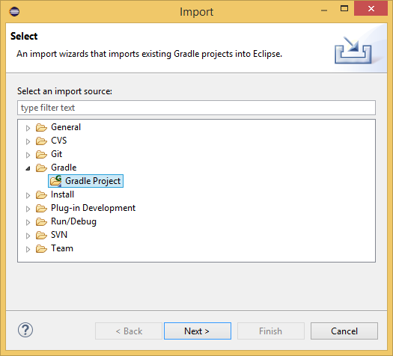
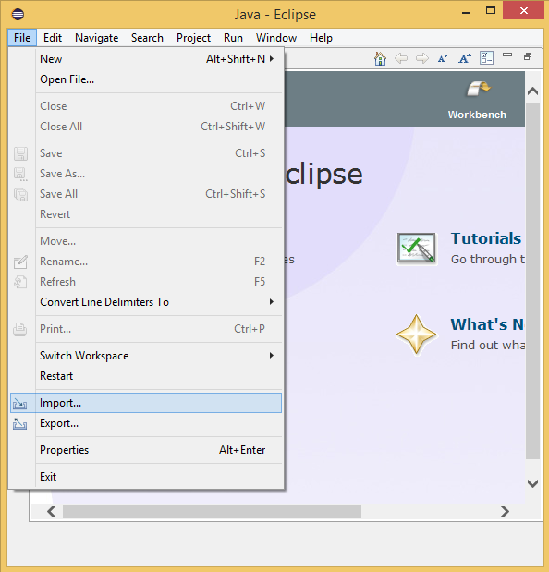
Import Our Project!

Slide 11
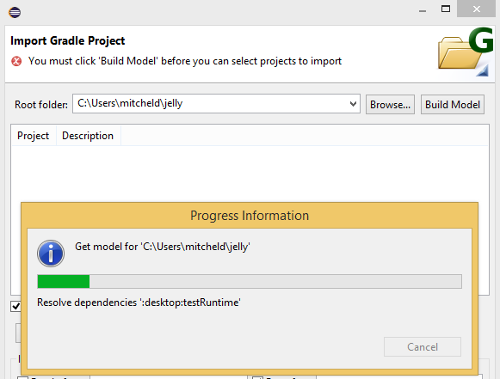
Import Our Project!
Use the path you saved your LibGDX output to
Remember this?

Slide 12
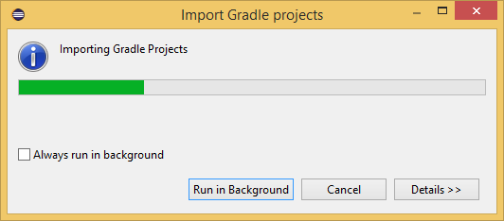


Import Our Project!
MAKE SURE TO CHECK EVERYTHING!
Note: If it asks you to install any “Connectors” you can just click “cancel”

Slide 13
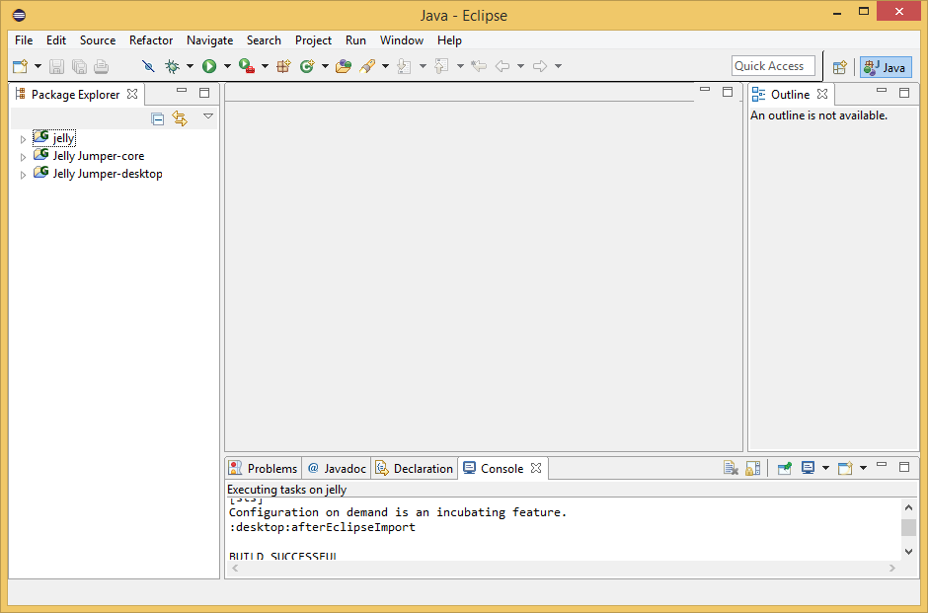
All Done
You should be able to see your projects now!

